Slide 1
Unit 6
Hidden Surfaces and Shading

Slide 2
Back-Face Detection Method
When we project 3-D objects on a 2-D screen, we need to detect the faces that are hidden on 2D.
Back-Face detection, is an object space method in which objects and parts of objects are compared to find out the visible surfaces.

Slide 3
Let us consider a triangular surface that whose visibility needs to decided.
The idea is to check if the triangle will be facing away from the viewer or not.
If it does so, discard it for the current frame and move onto the next one.

Slide 4
Each surface has a normal vector.
If this normal vector is pointing in the direction of the center of projection, then it is a front face and can be seen by the viewer.
If this normal vector is pointing away from the center of projection, then it is a back face and can not be seen by the viewer.

Slide 5
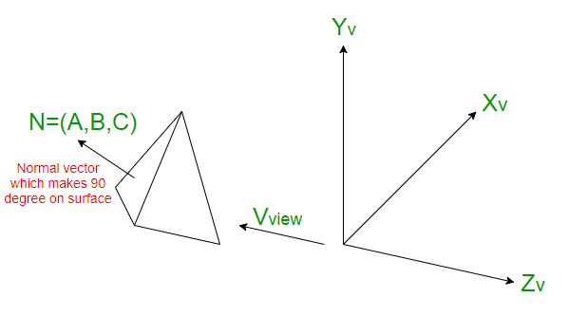

Slide 6
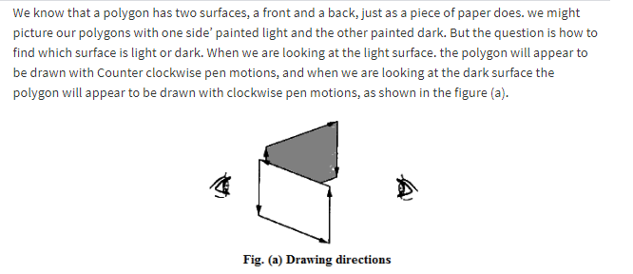

Slide 7
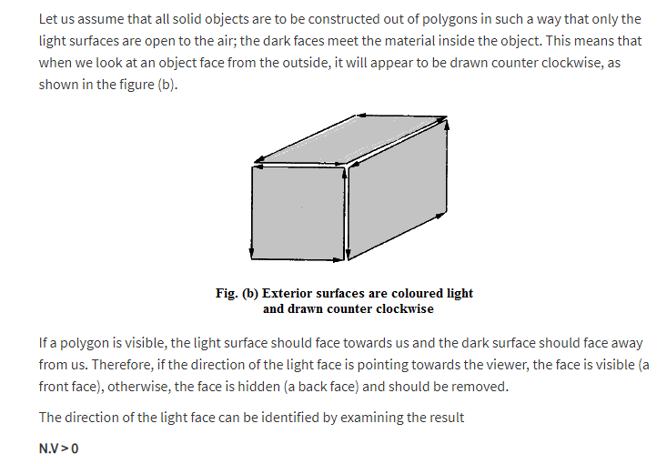

Slide 8
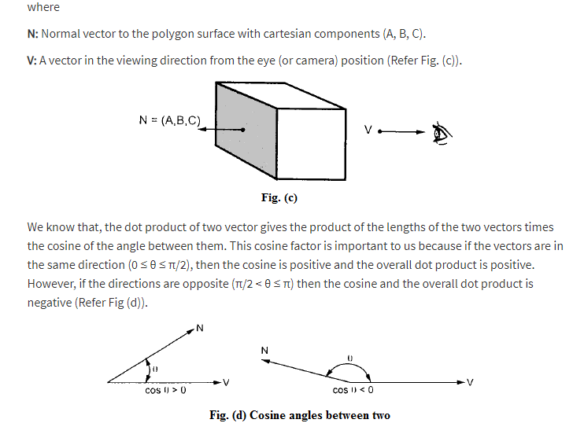
HINT:
2π =360⁰
π =180⁰
π/2=90⁰

Slide 9
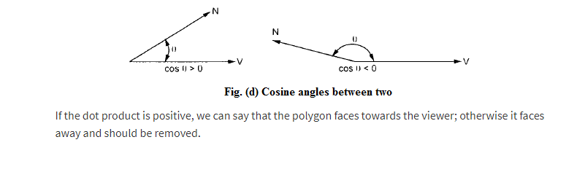

Slide 10
